Slide 1

Warehouse Management Database Project
Implementation of SQL Queries and Database Design
Moustafa Elsaid
TDIFUC22

Slide 2

Database Design Overview
The database is designed for a warehouse management system with tables like Suppliers, Products, Orders, Shipments, and Employees. Each table has its relevant columns with proper data types.

Slide 3
Tables and Primary Keys
1. Suppliers: SupplierID (PK), SupplierName, ContactName, ContactEmail
2. Products: ProductID (PK), ProductName, QuantityInStock, Price, SupplierID (FK)
3. Orders: OrderID (PK), OrderDate, EmployeeID (FK)
4. Shipments: ShipmentID (PK), OrderID (FK), ShipmentDate, Status
5. Employees: EmployeeID (PK), FirstName, LastName, Position, DateHired
6. Order_Products: OrderID (FK), ProductID (FK), Quantity

Slide 4
Foreign Keys and Relationships
1. Products ->Suppliers (SupplierID)
2. Order_Products ->Products (ProductID)
3. Orders -> Employees (EmployeeID)
4. Shipments -> Orders (OrderID)
5. Order_Products -> Orders (OrderID)

Slide 5
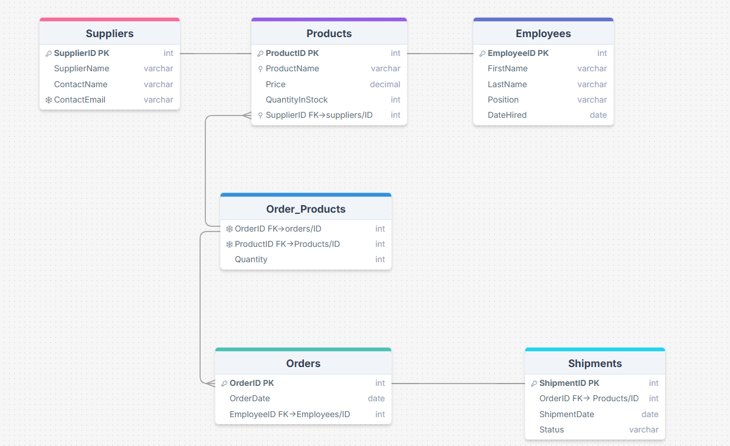
Database Schema (Visual Representation)

Slide 6
SQL Queries
1. Query for inserting data: INSERT INTO Suppliers (SupplierName, ContactName, ContactEmail) VALUES ('Supplier A', 'John Doe', 'john@example.com');
2. Query for selecting data: SELECT ProductName, Price FROM Products WHERE QuantityInStock > 100;
3. Query for updating data: UPDATE Products SET Price = 20.99 WHERE ProductID = 1;
4. Query for deleting data: DELETE FROM Products WHERE ProductID = 1;

Slide 7
Aggregate Functions and Group By
1. COUNT: SELECT COUNT(*) FROM Orders;
2. AVG: SELECT AVG(Price) FROM Products;
3. SUM: SELECT SUM(QuantityInStock) FROM Products;
Group By: SELECT EmployeeID, COUNT(*) FROM Orders GROUP BY EmployeeID;

Slide 8
GROUP BY Clause
SELECT SupplierID, COUNT(*) AS ProductCount
FROM Products
GROUP BY SupplierID;
Explanation: Retrieves the count of products supplied by each supplier, grouped by SupplierID.

Slide 9
ORDER BY Clause
SELECT ProductName, Price
FROM Products
ORDER BY Price DESC;
Explanation: Retrieves product names and prices, ordered by price in descending order.

Slide 10
Joining Tables with INNER JOIN
SELECT Orders.OrderID, Products.ProductName, Order_Products.Quantity
FROM Orders
INNER JOIN Order_Products ON Orders.OrderID = Order_Products.OrderID
INNER JOIN Products ON Order_Products.ProductID = Products.ProductID;
Explanation: Retrieves the order ID, product name, and quantity of each product in the order.

Slide 11
LEFT JOIN and RIGHT JOIN
SELECT Orders.OrderID, Employees.FirstName, Employees.LastName
FROM Orders
LEFT JOIN Employees ON Orders.EmployeeID = Employees.EmployeeID;
Explanation: Retrieves all orders, including those without an associated employee, using LEFT JOIN.

Slide 12
Pagination with OFFSET and FETCH
SELECT ProductName, Price
FROM Products
ORDER BY Price
OFFSET 10 ROWS FETCH NEXT 10 ROWS ONLY;
Explanation: Retrieves products with pagination (10 products starting from the 11th record).

Slide 13
Using Views for Simplification
CREATE VIEW ProductView AS
SELECT ProductName, Price
FROM Products
WHERE Price > 100;
Explanation: Creates a view that simplifies querying products with a price greater than 100.

Slide 14
Creating Stored Procedures
CREATE PROCEDURE GetEmployeeOrders
@EmployeeID INT
AS
BEGIN
SELECT Orders.OrderID, Orders.OrderDate
FROM Orders
WHERE Orders.EmployeeID = @EmployeeID;
END;
Explanation: A stored procedure to get all orders handled by a specific employee.

Slide 15
Using Triggers for Automated Actions
CREATE TRIGGER UpdateStockAfterOrder
ON Order_Products
AFTER INSERT
AS
BEGIN
DECLARE @ProductID INT, @Quantity INT;
SELECT @ProductID = ProductID, @Quantity = Quantity FROM inserted;
UPDATE Products SET QuantityInStock = QuantityInStock - @Quantity WHERE ProductID = @ProductID;
END;
Explanation: A trigger that updates the product stock when an order is placed.

Slide 16
Final Query - Combining Multiple Operations
SELECT Orders.OrderID, Employees.FirstName, Employees.LastName, SUM(Order_Products.Quantity * Products.Price) AS TotalAmount
FROM Orders
INNER JOIN Employees ON Orders.EmployeeID = Employees.EmployeeID
INNER JOIN Order_Products ON Orders.OrderID = Order_Products.OrderID
INNER JOIN Products ON Order_Products.ProductID = Products.ProductID
GROUP BY Orders.OrderID, Employees.FirstName, Employees.LastName
ORDER BY TotalAmount DESC;
Explanation: Retrieves the total amount of each order, grouped by order ID and employee, and ordered by total amount in descending order.

Slide 17
Conclusion and Explanation
In this project, I implemented key concepts such as Primary Keys, Foreign Keys, Indexing, and Aggregate Functions to ensure data integrity and efficient query performance.

Slide 18
GitHub/Version Control
All project files have been uploaded to GitHub for version control and sharing. Link: [GitHub Repository URL]

